Slide 1
C++ Programming:
From Problem Analysis to Program Design, Third Edition
Chapter 16: Exception Handling

Slide 2
Objectives
In this chapter you will:
Learn what an exception is
Learn how to handle exceptions within a program
See how a try/catch block is used to handle exceptions
Become familiar with C++ exception classes
C++ Programming: From Problem Analysis to Program Design, Third Edition

Slide 3
Objectives (continued)
Learn how to create your own exception classes
Discover how to throw and rethrow an exception
C++ Programming: From Problem Analysis to Program Design, Third Edition

Slide 4
Exceptions
Exception: undesirable event detectable during program execution
If exceptions occurred during execution
  Programmer-supplied code terminated the program or
  Program terminated with an appropriate error message
Can add exception-handling code at point where an error can occur
C++ Programming: From Problem Analysis to Program Design, Third Edition

Slide 5
Handling Exceptions within a Program (continued)
Function assert:
  Checks if an expression meets certain condition(s)
  If conditions are not met, it terminates the program
Example: division by 0
  If divisor is zero, assert terminates the program with an error message
C++ Programming: From Problem Analysis to Program Design, Third Edition

Slide 6
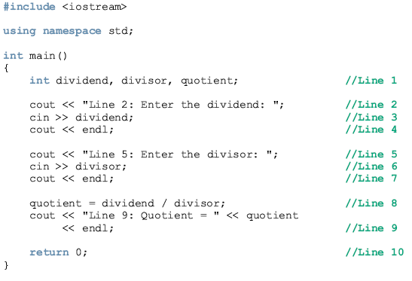
Example 16-1

Slide 7
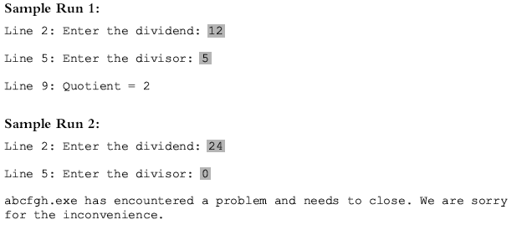

Slide 8
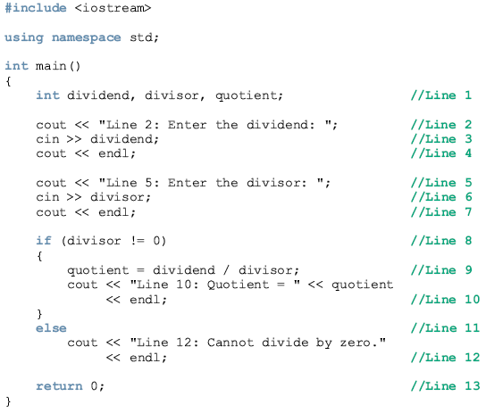
Example 16-2

Slide 9
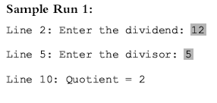
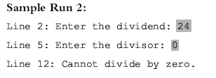

Slide 10
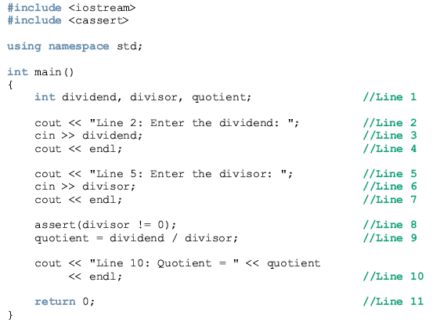
Example 16-3

Slide 11
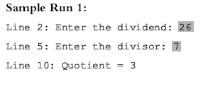
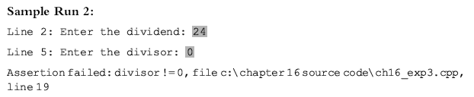

Slide 12
C++ Mechanisms of Exception Handling
The try/catch block handles exceptions
Exception must be thrown in a try block and caught by a catch block
C++ provides support to handle exceptions via a hierarchy of classes
C++ Programming: From Problem Analysis to Program Design, Third Edition

Slide 13
try/catch Block
Statements that may generate an exception are placed in a try block
The try block also contains statements that should not be executed if an exception occurs
The try block is followed by one or more catch blocks
C++ Programming: From Problem Analysis to Program Design, Third Edition

Slide 14
try/catch Block (continued)
The catch block:
  Specifies the type of exception it can catch
  Contains an exception handler
If the heading of a catch block contains ... (ellipses) in place of parameters
  Catch block can catch exceptions of all types
C++ Programming: From Problem Analysis to Program Design, Third Edition

Slide 15
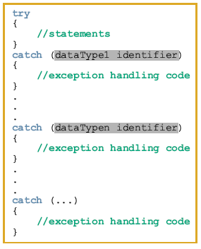
General syntax of the try/catch block:

Slide 16
try/catch Block (continued)
If no exception is thrown in a try block
  All catch blocks for that try block are ignored
  Execution resumes after the last catch block
If an exception is thrown in a try block
  Remaining statements in that try block are ignored
C++ Programming: From Problem Analysis to Program Design, Third Edition

Slide 17
try/catch Block (continued)
The program searches catch blocks in order, looking for an appropriate exception handler
If the type of thrown exception matches the parameter type in one of the catch blocks:
  Code of that catch block executes
  Remaining catch blocks are ignored
C++ Programming: From Problem Analysis to Program Design, Third Edition

Slide 18
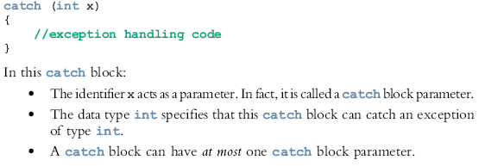

Slide 19

Throwing an Exception
For try/catch to work, the exception must be thrown in the try block
General syntax to throw an exception is:
  where expression is a constant value, variable, or object
C++ Programming: From Problem Analysis to Program Design, Third Edition

Slide 20
Throwing an Exception (continued)
The object being thrown can be
  Specific object
  Anonymous object
In C++
  An exception is a value
  throw is a reserved word
C++ Programming: From Problem Analysis to Program Design, Third Edition

Slide 21
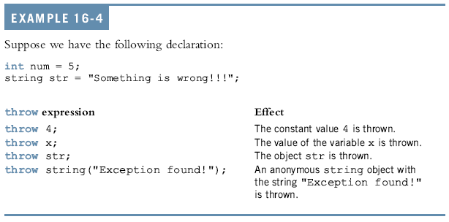
Throwing an Exception:

Slide 22
Order of catch Blocks
catch block can catch
  All exceptions of a specific type
  All types of exceptions
A catch block with an ellipses (three dots) catches any type of exception
In a sequence of try/catch blocks, if the catch block with an ellipses is needed
  It should be the last catch block of that sequence
C++ Programming: From Problem Analysis to Program Design, Third Edition

Slide 23
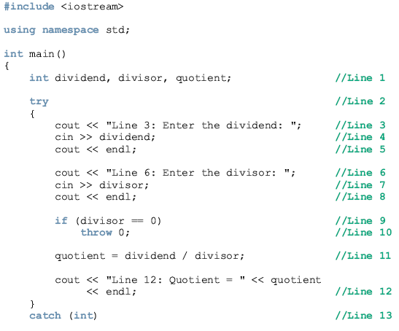
Using try/catch Blocks in a Program:

Slide 24
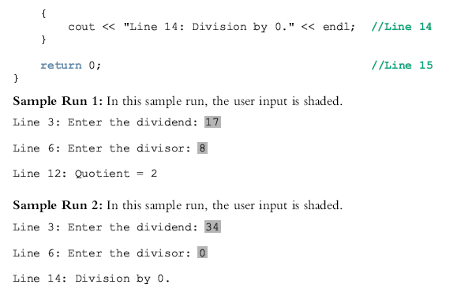

Slide 25

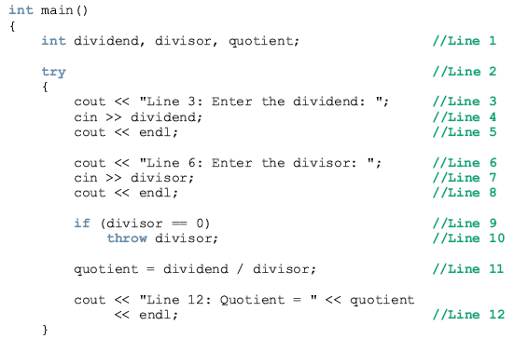
Example 16-6

Slide 26
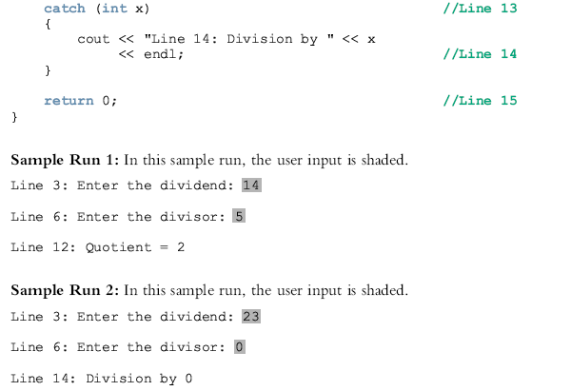

Slide 27
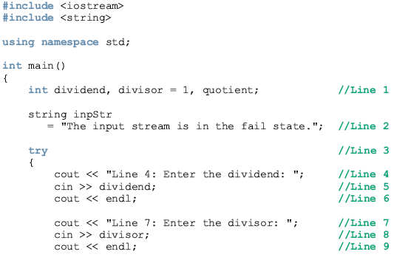
Example 16-7

Slide 28
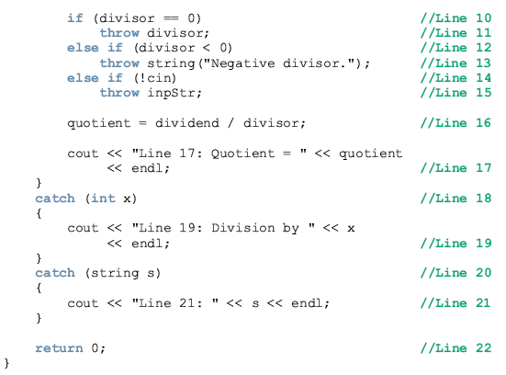

Slide 29
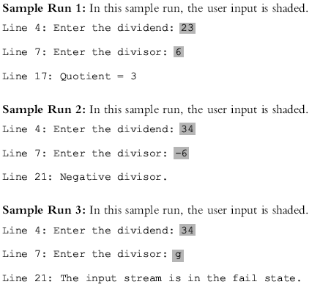

Slide 30
Using C++ Exception Classes
C++ provides support to handle exceptions via hierarchy of classes
The function what returns the string containing the exception object thrown by C++’s built-in exception classes
The class exception is:
  The base class of the exception classes provided by C++
  Contained in the header file exception
C++ Programming: From Problem Analysis to Program Design, Third Edition

Slide 31
Using C++ Exception Classes (continued)
Two classes derived from exception:
  logic_error
  runtime_error
logic_error and runtime_error are defined in header file stdexcept
The class invalid_argument deals with illegal arguments used in a function call
C++ Programming: From Problem Analysis to Program Design, Third Edition

Slide 32
Using C++ Exception Classes (continued)
The class out_of_range deals with the string subscript out_of_range error
The class length_error handles the error if
  A length greater than the maximum allowed for a string object is used
C++ Programming: From Problem Analysis to Program Design, Third Edition

Slide 33
Using C++ Exception Classes (continued)
If the operator new cannot allocate memory space
  It throws a bad_alloc exception
The class runtime_error deals with errors that occur only during program execution
Classes overflow_error and underflow_error
  Deal with arithmetic overflow and under-flow exceptions
  Derived from the class runtime_error
C++ Programming: From Problem Analysis to Program Design, Third Edition

Slide 34
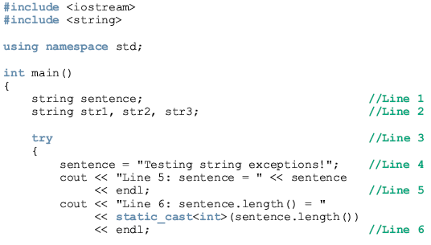
Example 16-8: exceptions out_of_range and length_error

Slide 35
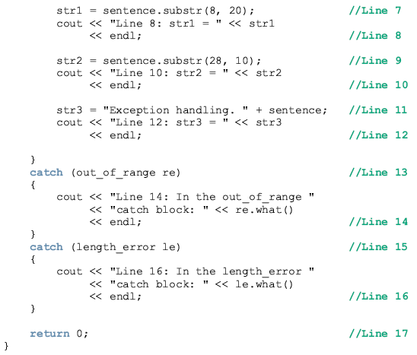

Slide 36
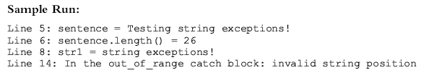

Slide 37
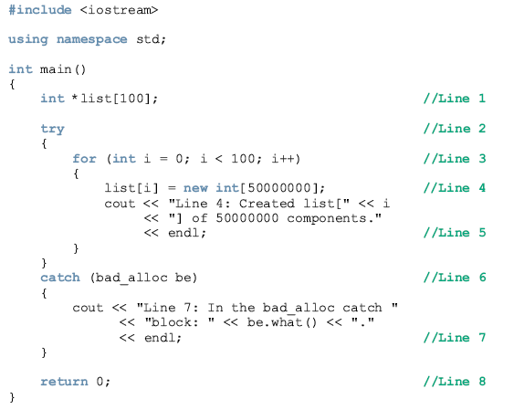
Example 16-9: exception bad_alloc

Slide 38
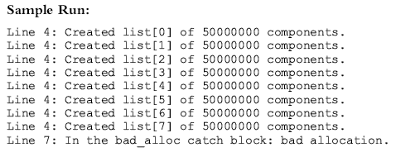

Slide 39
Creating Your Own Exception Classes
Programmers can create exception classes to handle exceptions not covered by C++’s exception classes and their own exceptions
C++ uses the same mechanism to process the exceptions you define as for built-in exceptions
You must throw your own exceptions using the throw statement
Any class can be an exception class
C++ Programming: From Problem Analysis to Program Design, Third Edition

Slide 40

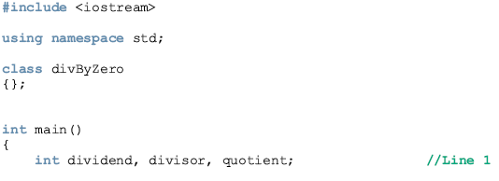
Example 16-10

Slide 41
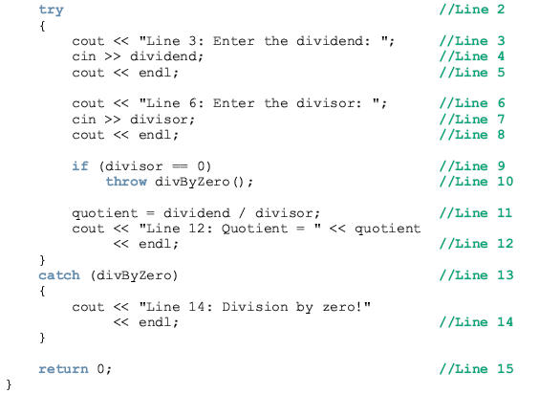

Slide 42
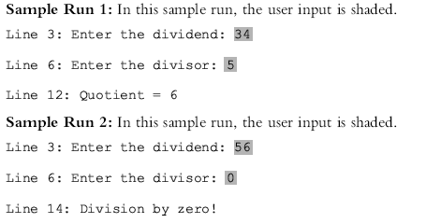

Slide 43
If you want to include members in your exception class, you typically include constructors and the function what.
Consider the following definition of the class divisionByZero:

Slide 44
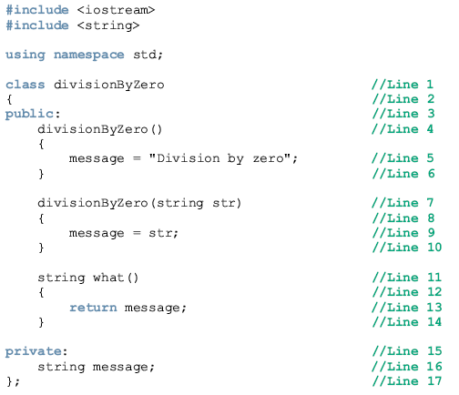

Slide 45
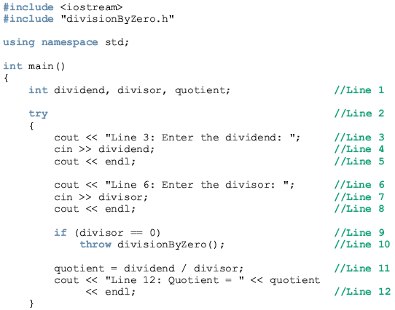
Example 16-11

Slide 46
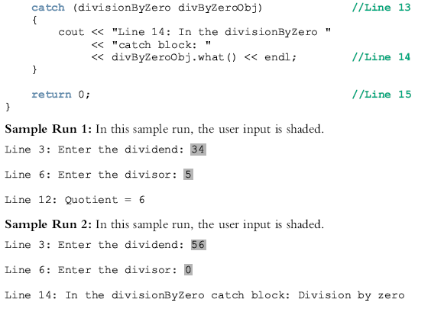

Slide 47
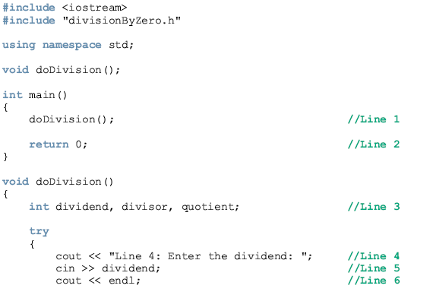
Example 16-13

Slide 48
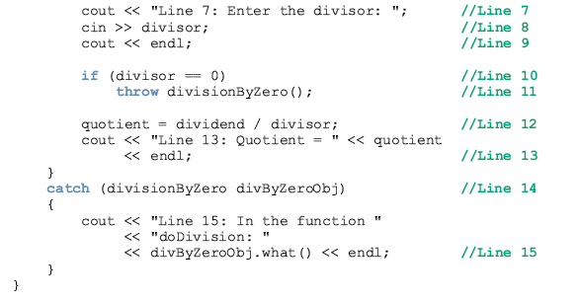

Slide 49
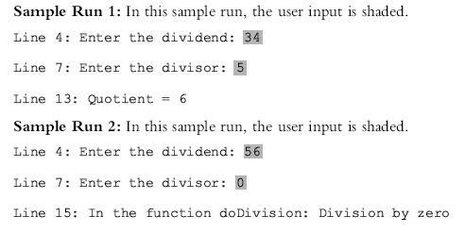

Slide 50
Rethrowing and Throwing an Exception
When an exception occurs in a try block
  Control immediately passes to one of the catch blocks
A catch block either
  Handles the exception or partially processes the exception and then rethrows the same exception OR
  Rethrows another exception for the calling environment to handle
C++ Programming: From Problem Analysis to Program Design, Third Edition

Slide 51


Rethrowing and Throwing an Exception (continued)
The general syntax to rethrow an exception caught by a catch block is:
(in this case, the same exception is rethrown) or:
where expression is a constant value, variable, or object
C++ Programming: From Problem Analysis to Program Design, Third Edition

Slide 52
Rethrowing and Throwing an Exception (continued)
The object being thrown can be
  A specific object
  An anonymous object
A function specifies the exceptions it throws in its heading using the throw clause
C++ Programming: From Problem Analysis to Program Design, Third Edition

Slide 53
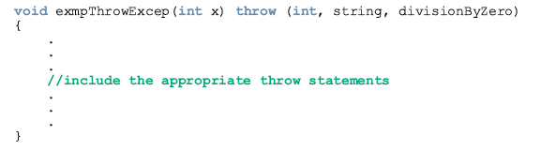
A function specifies the exceptions it throws (to be handled somewhere) in its heading using the throw clause.
For example, the following function specifies that it throws exceptions of type int, string, and divisionByZero, where divisionByZero is the class as defined previously.

Slide 54
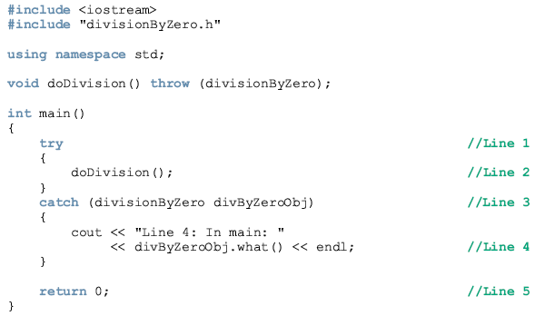
Example 16-14

Slide 55
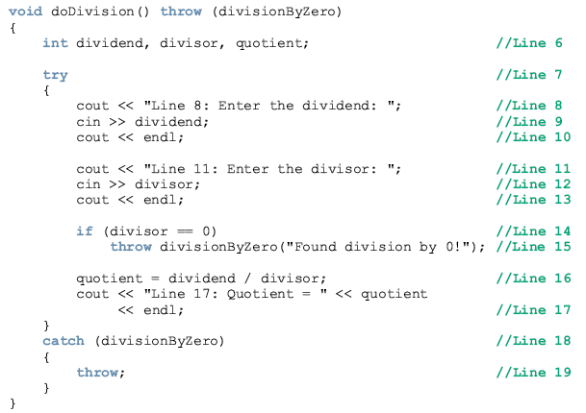

Slide 56
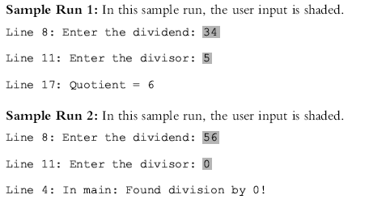

Slide 57
Exception Handling Techniques
When an exception occurs, the programmer usually has three choices:
  Terminate the program
  Include code to recover from the exception
  Log the error and continue
C++ Programming: From Problem Analysis to Program Design, Third Edition

Slide 58
Terminate the Program
In some cases, it is best to let the program terminate when an exception occurs
For example, if the input file does not exist when the program executes
  There is no point in continuing with the program
The program can output an appropriate error message and terminate
C++ Programming: From Problem Analysis to Program Design, Third Edition

Slide 59
Fix the Error and Continue
In some cases, you will want to handle the exception and let the program continue
For example, if a user inputs a letter in place of a number
  The input stream will enter the fail state
You can include the necessary code to keep prompting the user to input a number until the entry is valid
C++ Programming: From Problem Analysis to Program Design, Third Edition

Slide 60
Log the Error and Continue
For example, if your program is designed to run a nuclear reactor or continuously monitor a satellite
  It cannot be terminated if an exception occurs
When an exception occurs
  The program should write the exception into a file and continue to run
C++ Programming: From Problem Analysis to Program Design, Third Edition

Slide 61
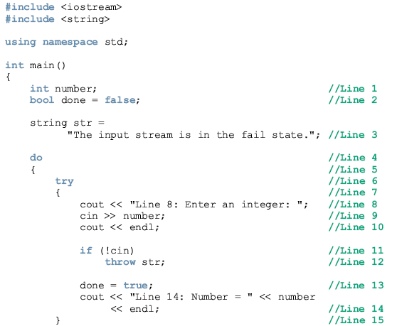
Example 16-16

Slide 62
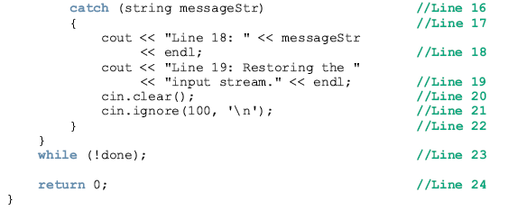

Slide 63
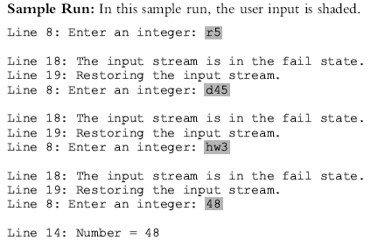

Slide 64
Stack Unwinding
When an exception is thrown in, say, a function, the function can do the following:
  Do nothing
  Partially process the exception and throw the same exception or a new exception
  Throw a new exception
C++ Programming: From Problem Analysis to Program Design, Third Edition

Slide 65
Stack Unwinding (continued)
In each of these cases, the function-call stack is unwound
  The exception can be caught in the next try/catch block
When the function call stack is unwound
  The function in which the exception was not caught and/or rethrown terminates
  Memory for its local variables is destroyed
C++ Programming: From Problem Analysis to Program Design, Third Edition

Slide 66
Stack Unwinding (continued)
The stack unwinding continues until
  A try/catch handles the exception or
  The program does not handle the exception
If the program does not handle the exception, then the function terminate is called to terminate the program
C++ Programming: From Problem Analysis to Program Design, Third Edition

Slide 67
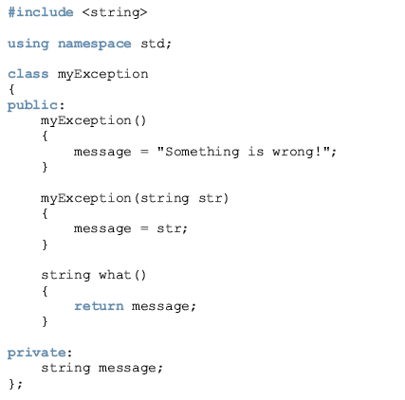

Slide 68
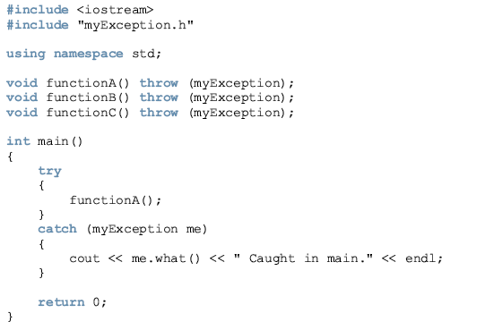
Example 16-17

Slide 69
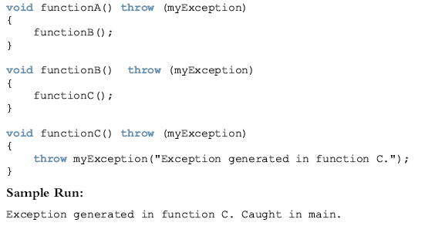

Slide 70
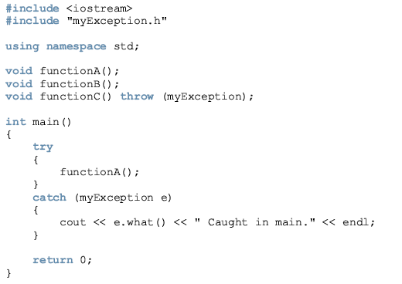
Example 16-18

Slide 71
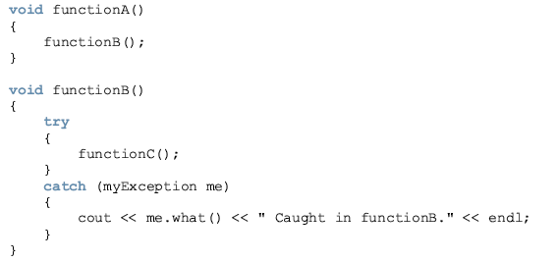
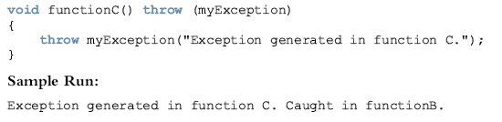

Slide 72
Summary
Exception: an undesirable event detectable during program execution
assert checks whether an expression meets a specified condition and terminates if not met
try/catch block handles exceptions
Statements that may generate an exception are placed in a try block
catch block specifies the type of exception it can catch and contains an exception handler
C++ Programming: From Problem Analysis to Program Design, Third Edition

Slide 73
Summary (continued)
If no exceptions are thrown in a try block, all catch blocks for that try block are ignored and execution resumes after the last catch block
Data type of catch block parameter specifies type of exception that catch block can catch
catch block can have at most one parameter
Exception is base class for exception classes
what returns string containing the exception object thrown by built-in exception classes
C++ Programming: From Problem Analysis to Program Design, Third Edition

Slide 74
Summary (continued)
Class exception is in the header file exception
runtime_error handles runtime errors
C++ enables programmers to create their own exception classes
A function specifies the exceptions it throws in its heading using the throw clause
If the program does not handle the exception, then the function terminate terminates the program
C++ Programming: From Problem Analysis to Program Design, Third Edition

